Slide 1

HEALTHCARE REPORT
GROUP 1
Caring for Lives, Empowering Health.

Slide 2
Table Contents
Project Overview
Key Indications (Data Transformation & Model)
Key Insights (Metrics & Visuals)
Key Implementation

Slide 3

Project Overview
The Key Objective is to analyze the healthcare data to identify Patient Demographics, Medical Insights, Admission Insights, Billing & Cost Analysis, Treatment Outcomes, and Hospital Performance.
The Health care data consists of 9,416 Doctors, 8,639 hospitals, 10,000 patients on admission, and 5 insurance providers.
SQL was used to query the data while Power Bl was used to visualize the patterns and insights related to patient conditions, outcomes, and treatment efficiency
These transformations, insights, and recommendations will help the hospital’s stakeholders make informed, data-driven decisions to enhance patient outcomes and operational efficiency.

Slide 4

Data Cleaning & Transformation (ETL)
Power query was used in Ms. Excel to clean and transform the dataset
Standard Consistency Checks were performed, Missing Data was identified, and Duplicate entries were handled appropriately to ensure data accuracy
.The Date of Admission` and `Discharge Date` columns were converted ` to `DATE` format. Some date columns were in text and then transformed to date data type as YYYY-MM-DD for SQL
The `Length of Stay` for each admission was calculated as the difference between `Discharge Date` and `Date of Admission`.
The `Age` column was segmented into groups (e.g., 18-34, 35-49, etc.) to analyze trends.
The cleaned data was checked to meet SQL Requirements by confirming Data types & then loaded into the Healthcare Database in Microsoft SQL Server where Window Functions, Joins, Common Table Expressions, and Conditional Aggregation are used to query the Data.

Slide 5
Data Dictionary
S/N | DATA | DESCRIPTION
1 | Name | Patient name
2 | Age | Age of the patient
3 | Gender | Blood type of the patient
4 | Medical Condition | Primary condition of the patient
5 | Date of Admission | Date the patient was admitted
6 | Blood Type | Blood type of the patient
7 | Doctor | Name of the doctor in charge or treating the patient
8 | Hospital | Name of the Hospital where the patient was admitted
9 | Insurance Provider | Name of the Insurance provider covering the patient
10 | Billing Amount | Total hospital bill amount (Treatment Cost)
11 | Room Number | Room number assigned to the patient
12 | Admission Type | Type of admission (Elective, Urgent or Emergency)
13 | Discharge Date | Date the patient was discharged
14 | Medication | Medication prescribed for the patient
15 | Test Results | Outcome of any medical tests (Normal, Abnormal or Inconclusive)
16 | Length of Stay | Difference between the Date of admission and Date of Discharge
18 | Patient ID | Unique Identifier for each patient
19 | Admission ID | Unique Identifier for each Patient on Admission
20 | Insurance ID | Unique Identifier for each Insurance Provider
21 | Hospital ID | Unique Identifier for each Hospital
22 | Doctor ID | Unique Identifier for each Doctor

Slide 6
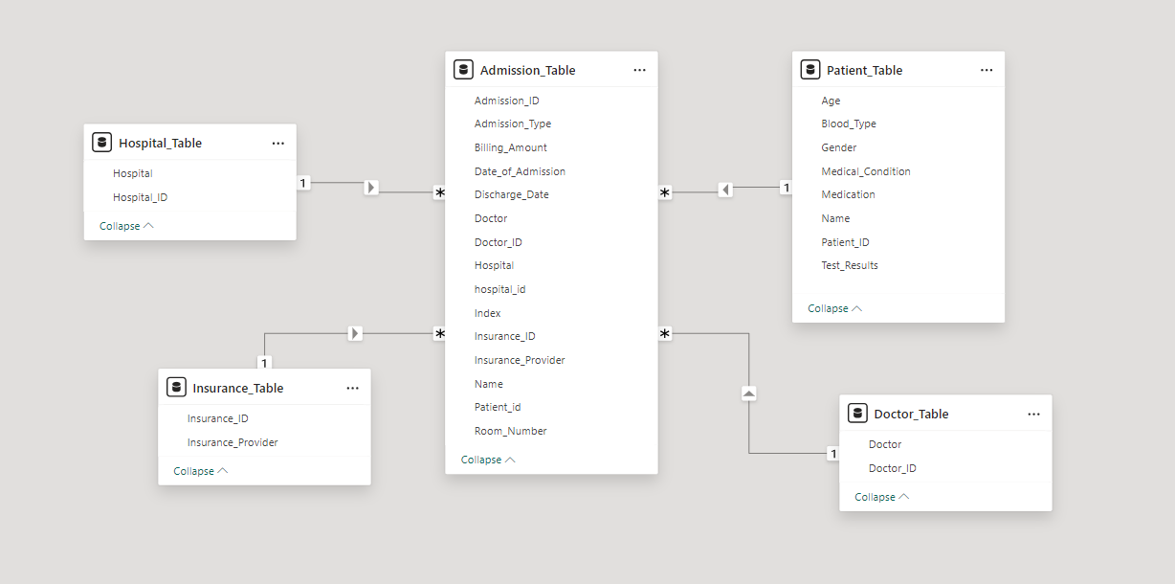
Data Modelling (Schema)

Slide 7
KEY INSIGHTS
Patient Demographics, Medical Insights, Admission Insights, Billing & Cost Analysis, Treatment Outcomes, and Hospital Performance.
Caring for Lives, Empowering Health.

Slide 8
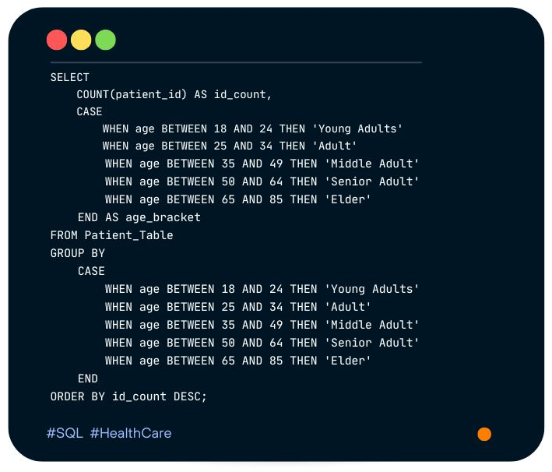
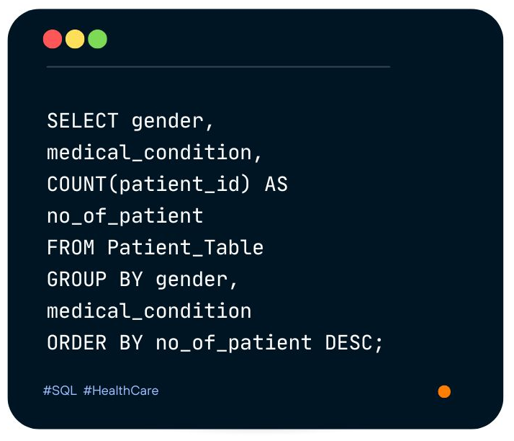
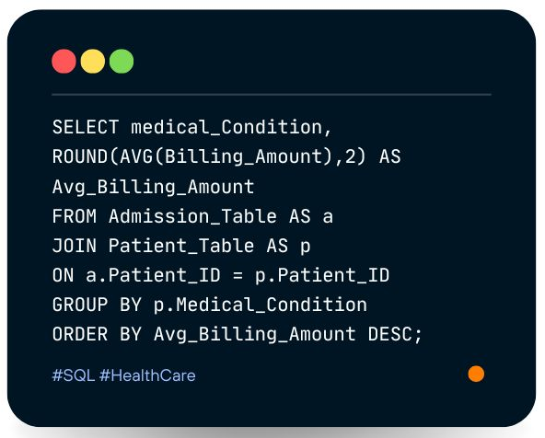
SQL Queries

Slide 9
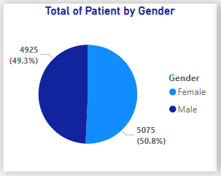
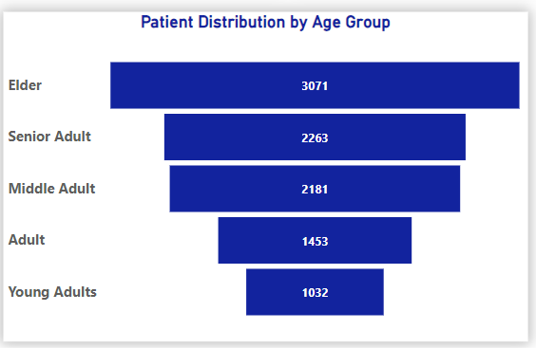
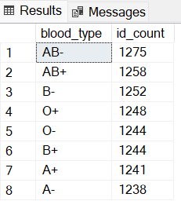
Patient Demographics
The data shows more females (5075) than males (4925).
The Health Care data has more Elderly patients (65-85 years old) while Young adults (18- 24 years old) are the least number of patients.
AB- is more common while A- is the least common blood type.

Slide 10
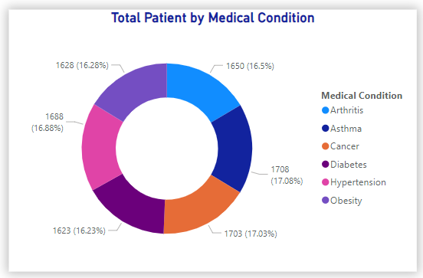
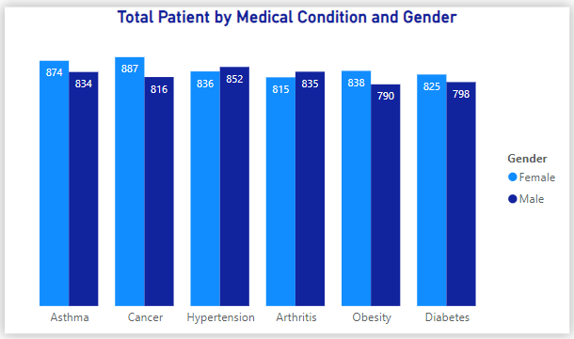
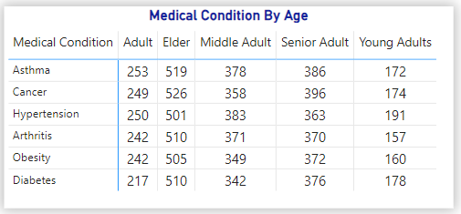

Medical Insights
Asthma and Cancer were the most prevalent medical conditions
Cancer showed a higher incidence among females, whereas Asthma was more frequently observed in males.
Elderly group has more medical conditions, while young adults have the least.

Slide 11
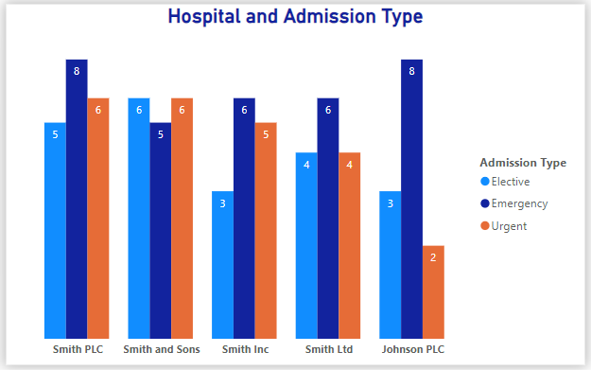
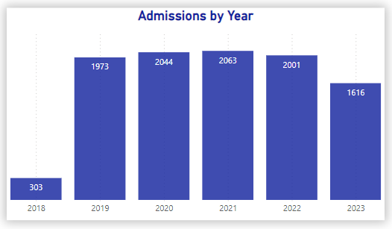
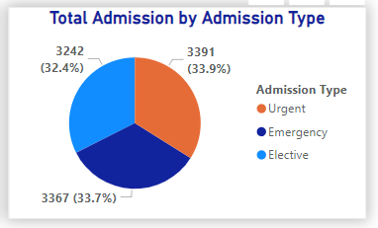
Admission Insights
Urgent Admission has more prevalence than the other types.
Smith PLC has the highest number of admissions per hospital, followed by Smith and Sons. Smith Inc. and Smith Ltd. had considerably the same number of admissions respectively.
The Year 2021 had the most admissions, while 2018 had the least among the hospitals. Also, admissions significantly increased between 2019 and 2020, possibly related to the COVID-19 pandemic.

Slide 12
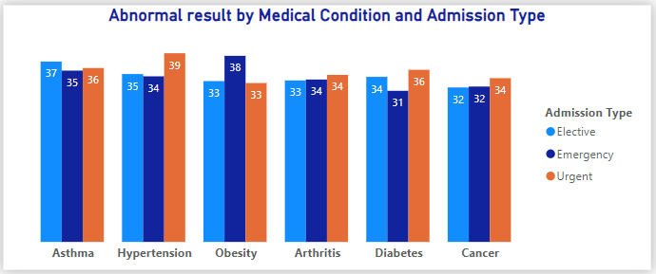
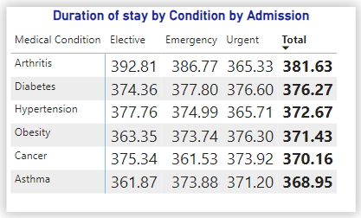
Admission Insights (Cont’d)
Hypertension recorded the highest frequency of abnormal results in Urgent admissions, followed by Obesity in emergency and Asthma in Elective admissions.
Elective admission had the longest of about 393hours, while emergency admission had the least average stay (361.5hrs) in the hospital
Arthritis had the most extended stay, then Asthma and Cancer had a wide range of recovery speeds (average shorter stay). While Hypertension, followed by Obesity, mainly showed moderate recovery rates, with fewer cases of rapid recovery.

Slide 13
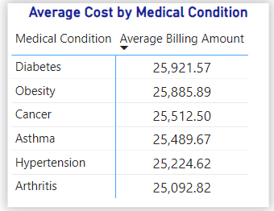
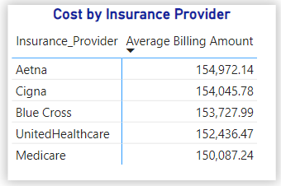
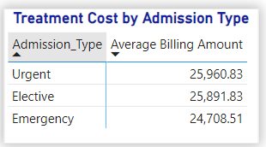
Billing & Cost Analysis
Patients with Diabetes paid the highest treatment costs, followed by those with Obesity conditions, with Arthritis treatments costing the least.
Aetna insurance providers, cover on average have the highest cost while Medicare covers the least cost of treatment.
The Cost of Urgent admission is higher while emergency is the least.

Slide 14
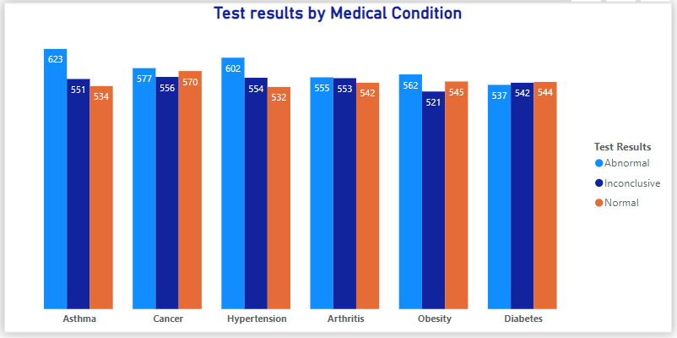
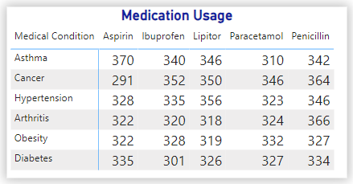
Treatment Outcomes
Asthma recorded the highest frequency of abnormal results, while Cancer displayed the greatest proportion of inconclusive and normal outcomes.
﻿Ibuprofen was mostly prescribed for the treatment of Cancer, Lipitor was most effective for Hypertension, Penicillin was most effective for Arthritis, Aspirin was most effective for Asthma, and Paracetamol was most effective for Obesity.

Slide 15
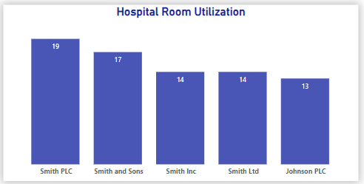
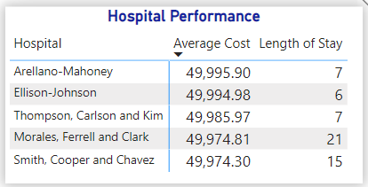
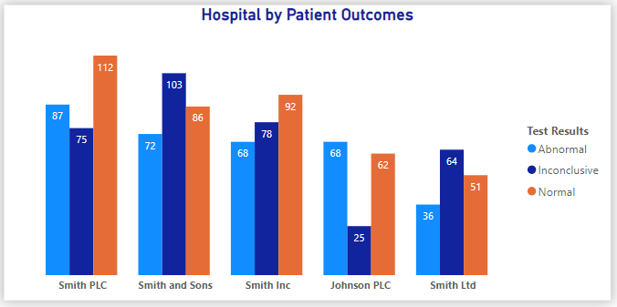
Hospital Performance
Smith PLC has the highest number of rooms in their hospital; hence they can accommodate more patients.
The top five hospitals have similar average treatment costs with varied lengths of Hospital stay.
Arellano-Mahoney Hospital, has the highest average billing amount with an average stay of 7 days amongst others.
Urgent admission in Smith PLC has the most extended stay followed by Inconclusive admission in Smith and Sons Hospital amongst the Top five(5) Hospitals by Length of Stay.

Slide 16
Key Implementation
Develop a Patient Feedback System through surveys and interviews to enhance care quality, and patient satisfaction and increase overall hospital efficiency.
Strengthen public health efforts on fitness, diet, and screenings to lower chronic conditions in at-risk adults.
Use data on insurance provider distribution to negotiate more favourable terms or expand coverage options with high-use providers, thereby increasing financial efficiency through better reimbursement terms.
Regularly Review and assess commonly used medications, high-cost treatments, and medications to identify cost-effective alternatives or negotiate bulk purchasing agreements with suppliers.
Invest in advanced diagnostic equipment or specialized staff training to enhance diagnostic accuracy and improve treatment outcomes.
Actively target Elderly (high-risk age) groups with preventive programs, emphasizing Asthma and Cancer, This proactive approach will help reduce unnecessary hospital admissions, particularly emergency visits.

Slide 17
THANK YOU
Caring for Lives, Empowering Health.

